Slide 1
Urology Community Health Talk: Male & Female Urology 101
Vince DiCarlo, MD

Slide 2
Overview
Urologic Anatomy
Male Urology
Enlarged Prostate/Benign Prostatic Hyperplasia (BPH)
Prostate Cancer Screening
Erectile Dysfunction
Female Urology
Overactive Bladder
Urinary Incontinence
Male + Female Urology
Urinary Tract Infections
Kidney Stones
Question & Answer

Slide 3
Anatomy

Slide 4
Overview
Urologic Anatomy
Male Urology
Enlarged Prostate/Benign Prostatic Hyperplasia (BPH)
Prostate Cancer Screening
Erectile Dysfunction
Female Urology
Overactive Bladder
Urinary Incontinence
Male + Female Urology
Urinary Tract Infections
Kidney Stones
Question & Answer

Slide 5
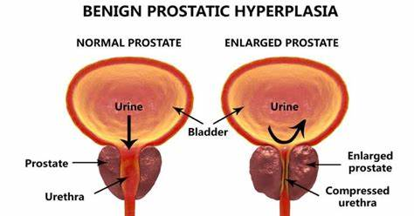
Male Urology: Enlarged Prostate
Commonly referred to as “benign prostatic hyperplasia”
Growth of prostate tissue → decreased flow of urine → bladder outlet obstruction

Slide 6
Male Urology: Enlarged Prostate
Common symptoms
Weak stream
Stopping/starting stream
Difficulty initiating stream
Nighttime urination
Dribbling after urination
Sensation of incomplete bladder emptying
Other Symptoms
Frequency
Urgency

Slide 7
Male Urology: Enlarged Prostate
70% of men affected in USA aged 60-69
80% of men affected in USA aged >70

Slide 8
Male Urology: Enlarged Prostate
Diagnosis & Workup
History & Physical
Urinalysis – rule out urinary tract infection
Symptom Questionnaire
Additional Options
Post urination bladder scan
Urocuff/Uroflow
Cystoscopy
Prostate ultrasound
Urodynamics

Slide 9
Male Urology: Enlarged Prostate
Management Options (3)
Lifestyle modifications
Timed voiding
Double voiding
Night time fluid restriction
Avoidance of caffeine, spicy foods (bladder irritants)
Medications
Alpha blockers
5-alpha reductase inhibitors
Procedures
More info to come

Slide 10
Male Urology: Enlarged Prostate
Medications: Alpha blockers
Flomax (tamsulosin)
Cardura (doxazosin)
Rapaflo (silodosin)
Uroxatral (alfuzosin)
Common side effects
Dizziness
Light headedness
Runny nose
Decreased ejaculation

Slide 11
Male Urology: Enlarged Prostate
Medications: 5 alpha reductase inhibitors
Shrinks prostate size over time
Examples
Proscar (finasteride)
Avodart (dutasteride)
Common side effects
Decreased libido
Erectile dysfunction

Slide 12
Male Urology: Enlarged Prostate
Procedures
Goal: create an open, unobstructed channel for urine to flow through

Slide 13
Male Urology: Enlarged Prostate
Procedures
Urolift
Rezum
Transurethral resection of prostate (TURP)
Greenlight laser photovaporization of prostate
Aquablation
Robotic simple prostatectomy
Procedure choice is dependent on workup features!

Slide 14
Male Urology: Enlarged Prostate
Transurethral resection of prostate (TURP)
“Gold standard” of enlarged prostate procedures
Endoscopic resection of prostate tissue
Best in prostates <80g on workup
Overnight stay in hospital*
Indwelling catheter 1-3 days
Risks/Common Side Effects
Bleeding
Decreased ejaculation
Incontinence

Slide 15
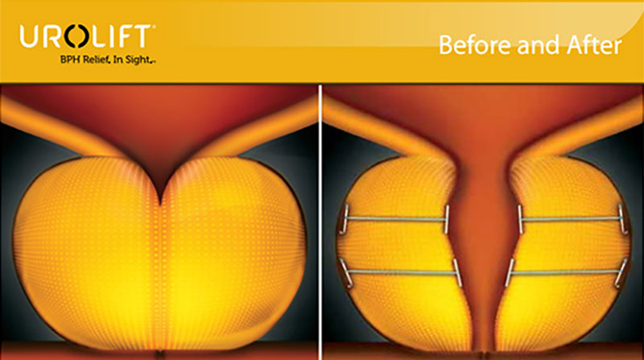
Male Urology: Enlarged Prostate
Urolift
Mechanical displacement of prostate tissue to create channel
Small prostates
Outpatient
Hospital
Surgery Center
Minimal catheter time post op
Low side effect profile

Slide 16
Male Urology: Enlarged Prostate
Rezum
Endoscopic injection of steam into prostate tissue leading to tissue death and shrinkage of prostate
Small prostates
Outpatient
Hospital
Surgery Center
Catheter 3-7 days
Common side effects
Irritative voiding for 1-2 weeks

Slide 17
Male Urology: Enlarged Prostate
Aquablation
Robotic guided hydrodissection
High powered water jet clears prostate tissue
Precise, ultrasound and robotic assisted
Prostates of all shapes/sizes
Overnight stay in hospital
Catheter for 2-5 days
Low side effect profile

Slide 18
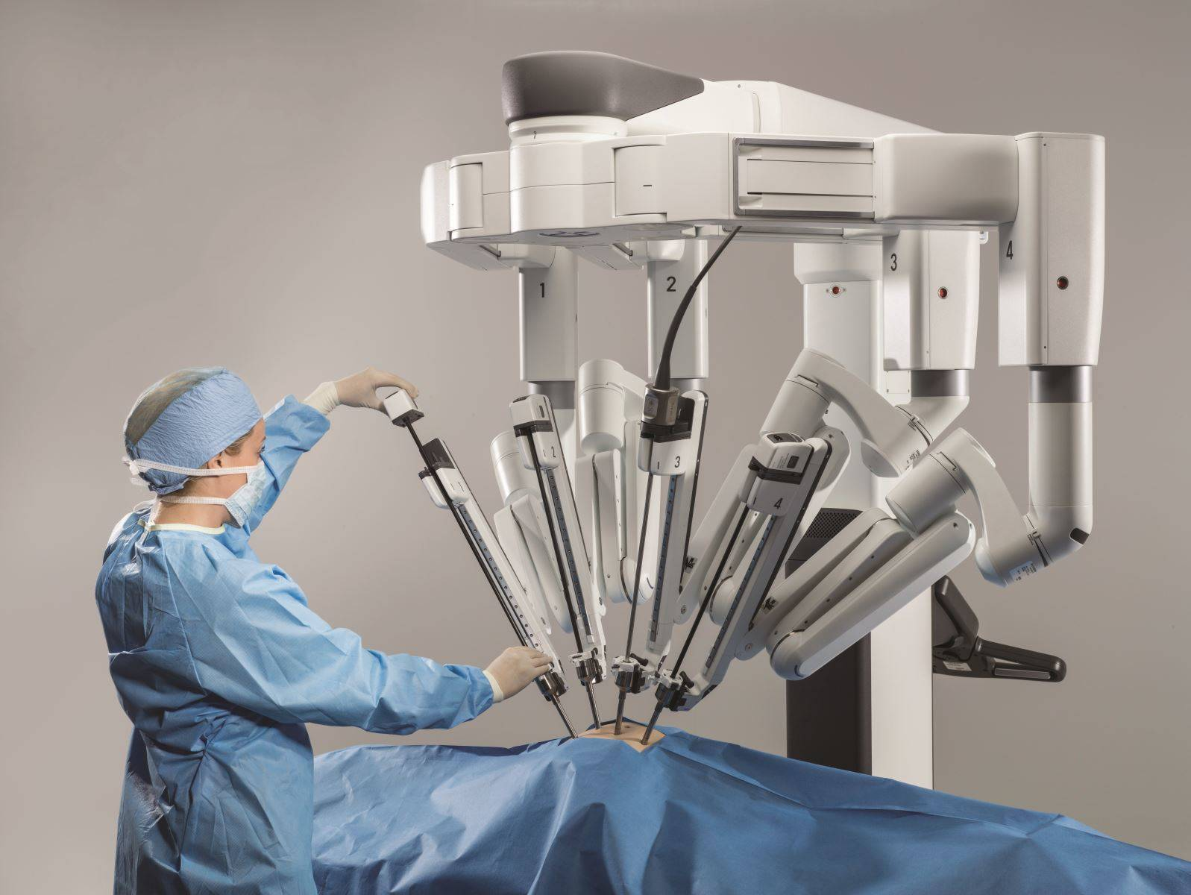
Male Urology: Enlarged Prostate
Robotic simple prostatectomy
Transabdominal procedure, robotic assisted laparoscopic surgery
Large prostates >80-100g
Overnight stay in hospital*
Most invasive procedure but often most efficient for large prostates

Slide 19
Overview
Urologic Anatomy
Male Urology
Enlarged Prostate/Benign Prostatic Hyperplasia (BPH)
Prostate Cancer Screening
Erectile Dysfunction
Female Urology
Overactive Bladder
Urinary Incontinence
Male + Female Urology
Urinary Tract Infections
Kidney Stones
Question & Answer

Slide 20
Male Urology: Prostate Cancer Screening
Most common cancer in men in USA
Average age of diagnosis: 67 yo
Prostate cancer screening
Has been controversial in past
Cancer screening goal = detect potentially lethal cancer at early stage in order to intervene with curative intention, and lower burden of overall treatment
Concern regarding over-diagnosis, over-treatment
Led to updated prostate cancer screening guidelines in 2000-2010s

Slide 21
Male Urology: Prostate Cancer Screening
How do we screen?
PSA = Prostate Specific Antigen
Protein produced by prostate cells → increased production w cancer
Routine blood draw
Not a “perfect” test → infection, trauma, enlarged gland can also raise PSA
DRE = Digital Rectal Examination
When do we screen? (per American Urological Association Guidelines)
<40 yo: not recommended
40-54 yo: not recommended for average risk patient
High risk = +family history, African American race
50-69 yo: PSA every 1-2 yr
>70 yo: shared decision making

Slide 22
Male Urology: Prostate Cancer Screening
Adjuncts to screening
Multiparametric MRI prostate
Genetic biomarkers
4k score
SelectMDx
PCA3
The above are tools some Urologists use to determine need for biopsy, however they are not diagnostic and can not safely rule out prostate cancer

Slide 23
Male Urology: Prostate Cancer Screening
PSA > 4.0
Increased risk for prostate cancer
Typically confirmed with repeat PSA 1-3 weeks after initial blood draw
How do we diagnose prostate cancer?
Prostate biopsy
Ultrasound guided, transrectal
12 biopsy samples from prostate*
Performed in office or ambulatory surgery center

Slide 24
Male Urology: Prostate Cancer Screening
Treatment options for prostate cancer (non-metastatic)
Active surveillance
Surgery → robotic radical prostatectomy
Radiation
HIFU
Cryoablation

Slide 25
Overview
Urologic Anatomy
Male Urology
Enlarged Prostate/Benign Prostatic Hyperplasia (BPH)
Prostate Cancer Screening
Erectile Dysfunction
Female Urology
Overactive Bladder
Urinary Incontinence
Male + Female Urology
Urinary Tract Infections
Kidney Stones
Question & Answer

Slide 26
Male Urology: Erectile Dysfunction
Risk factors
Age
High blood pressure
Type II diabetes
Treatment options
Lifestyle modifications
Medications – sildenafil (Viagra), tadalafil (Cialis)
+/- vacuum erection pump
Injectable medications – Trimix, Bimix
Surgery – Inflatable penile prosthesis

Slide 27
Male Urology: Erectile Dysfunction
Medications – Important points
Appropriate timing of medications: 45-60 min prior to sexual activity
Sildenafil (Viagra) must be taken on an empty stomach
Sildenafil (Viagra) often given in 20mg or 25mg tablets
Maximum dose 100mg, can titrate up to maximum dose

Slide 28
Overview
Urologic Anatomy
Male Urology
Enlarged Prostate/Benign Prostatic Hyperplasia (BPH)
Prostate Cancer Screening
Erectile Dysfunction
Female Urology
Overactive Bladder
Urinary Incontinence
Male + Female Urology
Urinary Tract Infections
Kidney Stones
Question & Answer

Slide 29
Female Urology: Overactive Bladder
Definition = urinary urgency in the absence of infection or other obvious pathology
Affects approximately 20% of women in USA (15% of men)

Slide 30
Female Urology: Overactive Bladder
Evaluation
Rule out other causes
Infection, kidney stone, diabetes, malignancy, pelvic floor dysfunction
History & physical
Urinalysis
Additional options
Post urination bladder scan
Symptom questionnaires
Cystoscopy
Urodynamics

Slide 31
Female Urology: Overactive Bladder
Treatment Options
Conservative Measures
Medications
Procedures
Dietary measures
Pelvic floor physical therapy
Bladder control strategies
Anticholinergics
Beta 3 agonists
Bladder botox injections
Percutaneous tibial nerve stimulation
Sacral nerve stimulator

Slide 32
Female Urology: Overactive Bladder
Conservative Measures
Fluid limitation
Caffeine/spicy food avoidance
Pelvic floor physical therapy
Bladder control strategies

Slide 33
Female Urology: Overactive Bladder
Medications – “bladder relaxants”, decrease signaling activity
Anticholinergics
Oxybutynin (Ditropan)
Trospium (Sanctura)
Tolterodine (Detrol)
Solifenacin (Vesicare)
Side effects: dry mouth, constipation, dry eyes, mental status changes
Beta 3 agonists
Mirabegron (Myrbetriq) → side effect: raises blood pressure (10%)
Vibegron (Gemtesa) → side effect: headache (4%)

Slide 34
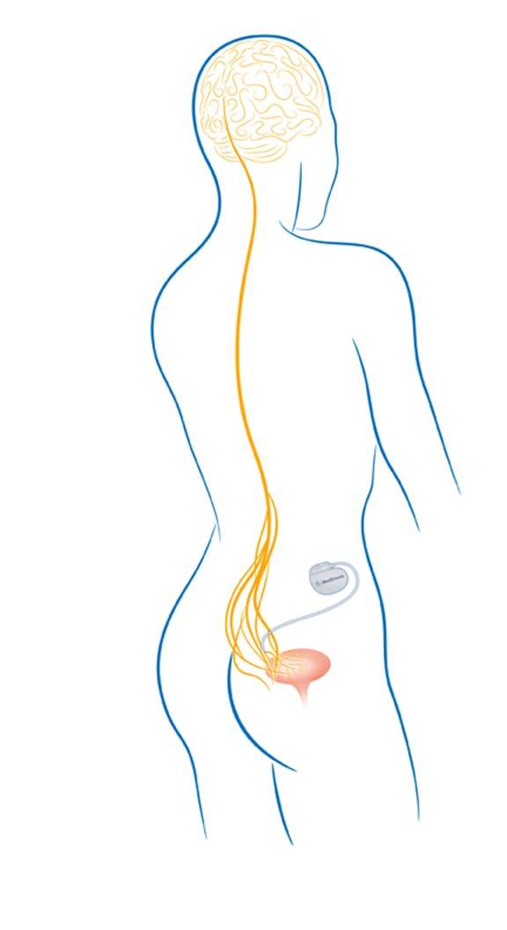
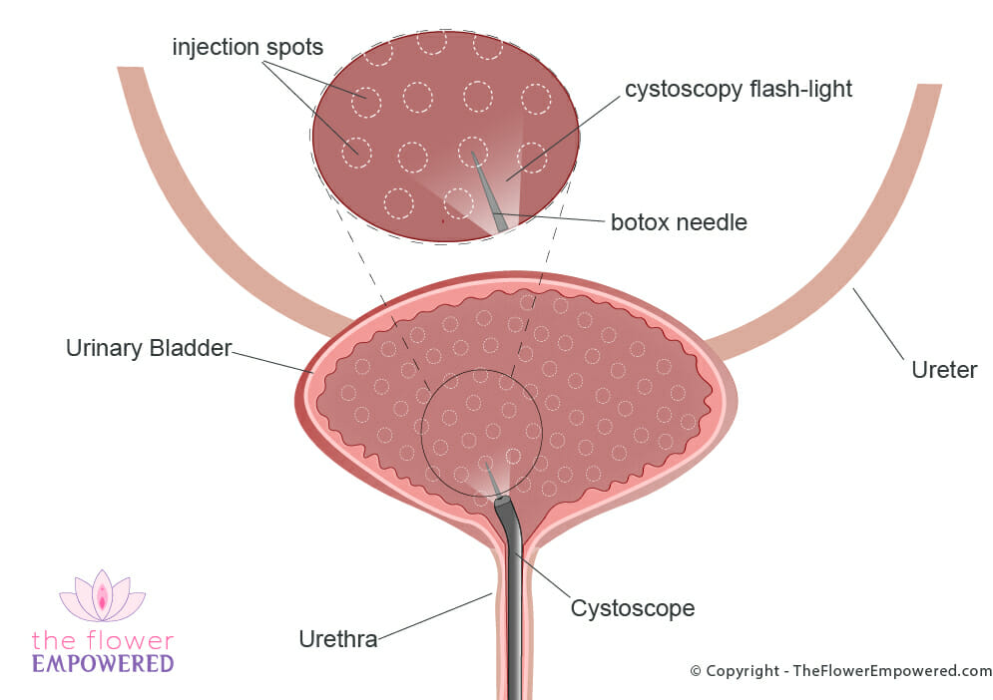
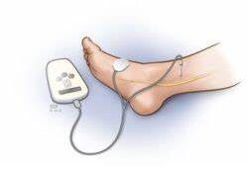
Female Urology: Overactive Bladder
Procedures
1. Bladder botox injections
2. Perctuaneous tibial nerve stimulation
3. Sacral nerve stimulator
Positives
Minimally invasive
Office/Surgery Center
Negatives
Wears off avg 6-9 mos
6% risk of urinary retention
Positives
Least invasive
Minimal risk
Negatives
Least effective
Time intensive

Slide 35
Female Urology: Overactive Bladder
Sacral nerve stimulator
Stimulation of nerve root to restore communication between bladder and spinal cord
Available products
Interstim
Axonics
Typically done in 2 phases
Test phase – temporary lead placed, symptoms monitored
Device implant – if symptoms improved

Slide 36
Female Urology: Overactive Bladder
Positives
Most effective
Newer products MRI compatible, rechargeable versions available
Negatives
Most invasive
Non-rechargeable versions may require replacement of battery (avg lifespan 10-15 yrs)

Slide 37
Female Urology: Urinary Incontinence
Definition: Involuntary loss of urine
Two broad categories
Urge urinary incontinence
Stress urinary incontinence
Majority of patients have both (mixed urinary incontinence)

Slide 38
Female Urology: Urinary Incontinence
Urge urinary incontinence
Progression of overactive bladder
Same treatment options

Slide 39
Female Urology: Urinary Incontinence
Stress urinary incontinence – involuntary loss of urine with increases in abdominal pressure
Laugh, cough, sneeze, exercise
Risk factors
Multiple children, vaginal deliveries
Age
Obesity
Smoking

Slide 40
Female Urology: Urinary Incontinence
Stress urinary incontinence – Management options
Observation – if minimally bothersome
Pelvic floor physical therapy, Kegel exercises
Continence pessary
Procedures
Injection of bulking agent
Sling placement

Slide 41
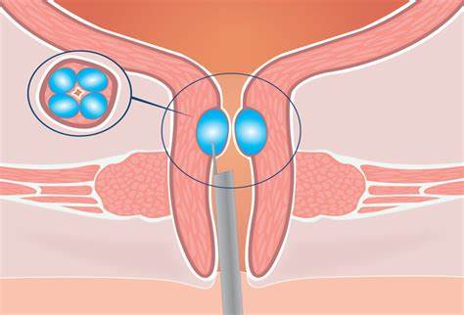
Female Urology: Urinary Incontinence
Stress urinary incontinence – injection of bulking agents
Bulkamid
Water soluble agent
Safe
Long lasting
Effective
Minimally invasive – often under local anesthesia

Slide 42
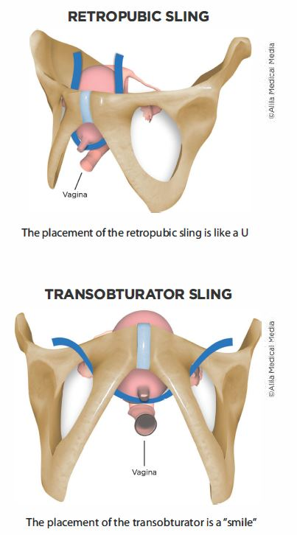
Female Urology: Urinary Incontinence
Stress urinary incontinence – sling procedures
Synthetic slings
Autologous fascial slings
Outpatient surgery
More invasive than bulking agents, slightly higher risks
Longer lasting than bulking agents

Slide 43
Overview
Urologic Anatomy
Male Urology
Enlarged Prostate/Benign Prostatic Hyperplasia (BPH)
Prostate Cancer Screening
Erectile Dysfunction
Female Urology
Overactive Bladder
Urinary Incontinence
Male + Female Urology
Urinary Tract Infections
Kidney Stones
Question & Answer

Slide 44
Urinary Tract Infections
Common symptoms
Increased urgency/frequency of urination
Burning with urination
Lower abdominal or low back pain
Fever
Mental status changes
Cloudy appearing urine**
Foul smelling urine**

Slide 45
Urinary Tract Infections
Risk factors
Diabetes
Obesity
Kidney stones
Indwelling catheter or other instrumentation of urinary tract

Slide 46
Urinary Tract Infections
Management
Should always have urine culture prior to starting antibiotics!!!
Treat with culture driven antibiotics
Goal is for shortest course that provides relief of symptoms
Increase hydration!!
Recurrent UTIs
Definition: >3 UTIs in a year or >2 in 6 months
Focus becomes prevention along with treatment

Slide 47
Urinary Tract Infections
Prevention
Increased fluid intake
Cranberry supplements
TheraCran One
Peri or post menopausal women – vaginal estrogen cream

Slide 48
Urinary Tract Infections
Asymptomatic Bacteriuria – An Important Concept
Bacteria in urine that is not causing acute symptoms
Routine urine tests at PCP, Urgent Care, ED, Urologist etc may show signs of bacteria
Does not require antibiotic treatment
Goal → limit antibiotic exposure to reduce antibiotic resistant bacterial strains

Slide 49
Overview
Urologic Anatomy
Male Urology
Enlarged Prostate/Benign Prostatic Hyperplasia (BPH)
Prostate Cancer Screening
Erectile Dysfunction
Female Urology
Overactive Bladder
Urinary Incontinence
Male + Female Urology
Urinary Tract Infections
Kidney Stones
Question & Answer

Slide 50
Kidney Stones
1 in 11 people in USA develop kidney stones in lifetime
Incidence peaks in 4th-6th decade of life
Most common in southern USA → “Kidney Stone Belt”
Risk factors
Dehydration
Obesity
Type II diabetes

Slide 51
Kidney Stones
Symptoms
Acute flank pain – sharp/stabbing, radiates to groin
Urinary urgency/frequency
Pink/red tinged urine
+/- fevers, chills, nausea, vomiting
Diagnosis
History & physical
Blood work – kidney function levels, urinalysis
Imaging – Kidney ultrasound, CT abd/pel

Slide 52
Kidney Stones

Slide 53
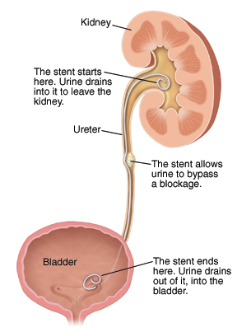
Kidney Stones
Management options
Depends on presence of infection
Obstructing stone with infection = timely drainage
Most common: ureteral stent
Percutaneous nephrostomy tube
Obstructing stone w/o infection
Trial of passage
Ureteroscopy, laser lithotripsy
Shock wave lithotripsy

Slide 54
Kidney Stones
Management options
Depends on presence of infection
Obstructing stone w/o infection
Trial of passage
Ureteroscopy, laser lithotripsy
Shock wave lithotripsy

Slide 55
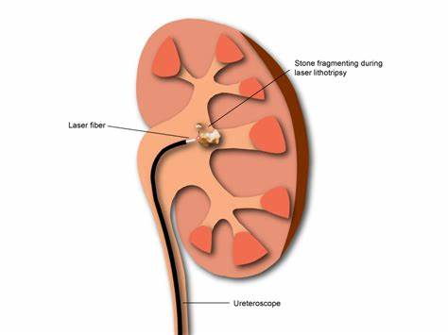
Kidney Stones
Ureteroscopy with laser lithotripsy
Outpatient endoscopic procedure
Stone broken into tiny fragments/debris with a laser fiber
Often requires temporary ureteral stent for 5-7d
Large stone burden may take 2-3 procedures to clear completely

Slide 56
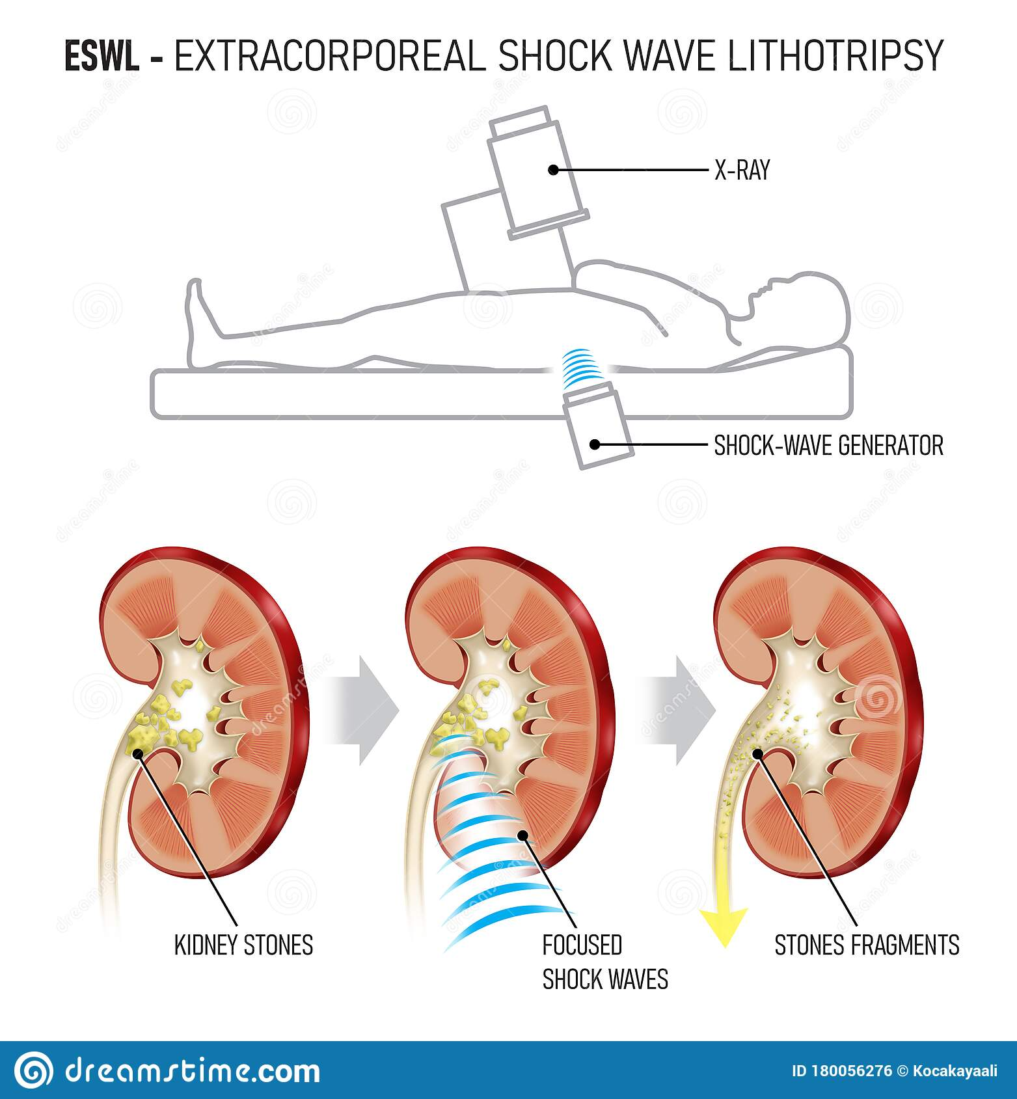
Kidney stones
Extracorporeal shock wave lithotripsy (ESWL)
External shock waves with radiographic targeting of stone
Typically no scope or stent required
Patient/stone selection is key
As stone size increases, success rates decline
Best for stones <10mm
Stones between 10-20mm → success depends on stone composition/location
Stones > 20mm ESWL not recommended
Limited success with stones in mid/distal ureter

Slide 57
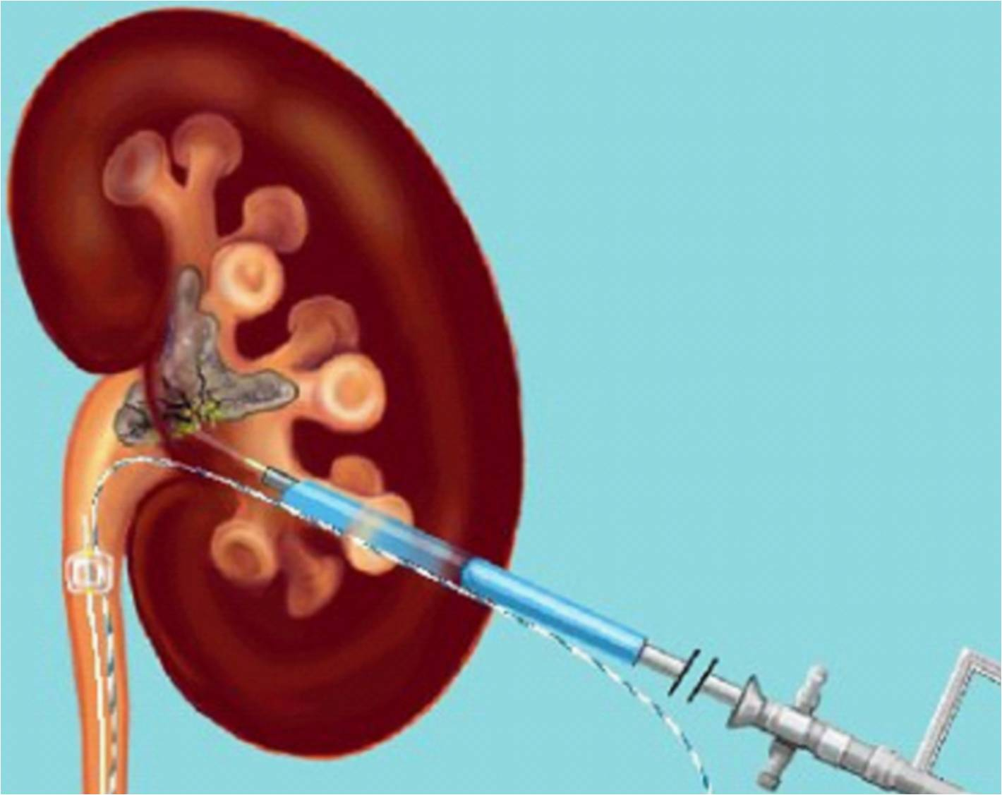
Kidney Stones
What to do for large stones (>20mm)?
Ureteroscopy with laser lithotripsy – may take 2-3 procedures
Percutaneous nephrolithotomy (PCNL)
Higher chance of complete stone clearance in 1 procedure
Direct access to kidney through back, allows for larger scopes/instruments
Small 1-2cm incision
Sometimes requires overnight stay in hopsital

Slide 58
Overview
Urologic Anatomy
Male Urology
Enlarged Prostate/Benign Prostatic Hyperplasia (BPH)
Prostate Cancer Screening
Erectile Dysfunction
Female Urology
Overactive Bladder
Urinary Incontinence
Male + Female Urology
Urinary Tract Infections
Kidney Stones
Question & Answer

Slide 59
Thank you!!
Questions?

Slide 60
Office Locations
Canton
470 Northside Cherokee Blvd, Suite 210 (770-720-7246)
Woodstock
900 Towne Lake Pkwy, Suite 200 (678-494-9201)
Ellijay
433 Highland Pkway, Suite 120 (770-720-7246)
www.gaurology.com

