Slide 1
Medicare 101

Slide 2
Who Can Get Medicare?
U.S. Citizens and Legal Residents
Legal residents must live in the U.S. for at least 5 years in a row, including the 5 years just before applying for Medicare.
You must also meet one of the following requirements:
Age 65 or older
Younger than65 with a qualifying disability
Any age with a diagnosis of end-stage renal disease or ALS

Slide 3
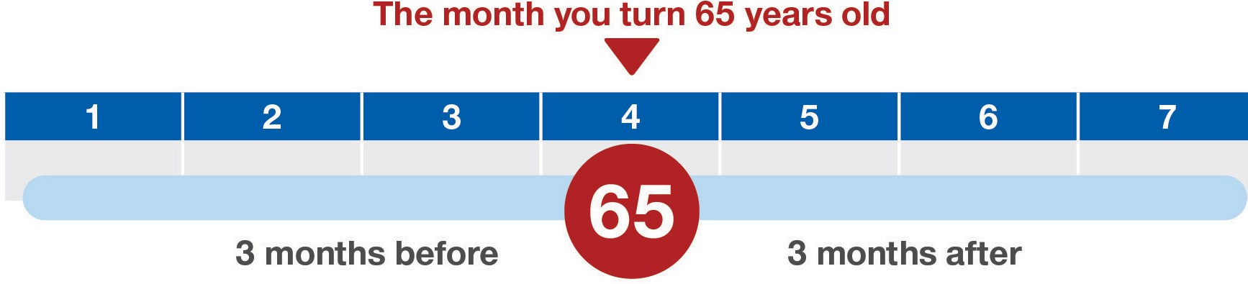
Initial Enrollment Period
Enrolled in Part A and Part B automatically if receiving Social Security or Railroad Retirement Board (RRB) benefits at age 65, or after receiving Social Security disability benefits for 24 months
Enroll yourself if not receiving benefits (go to SSA.gov or local office)
Enroll early to avoid gaps in coverage and late enrollment penalties
May refuse or delay enrollment in Part B
May enroll in a Medicare Advantage or a prescription drug plan

Slide 4
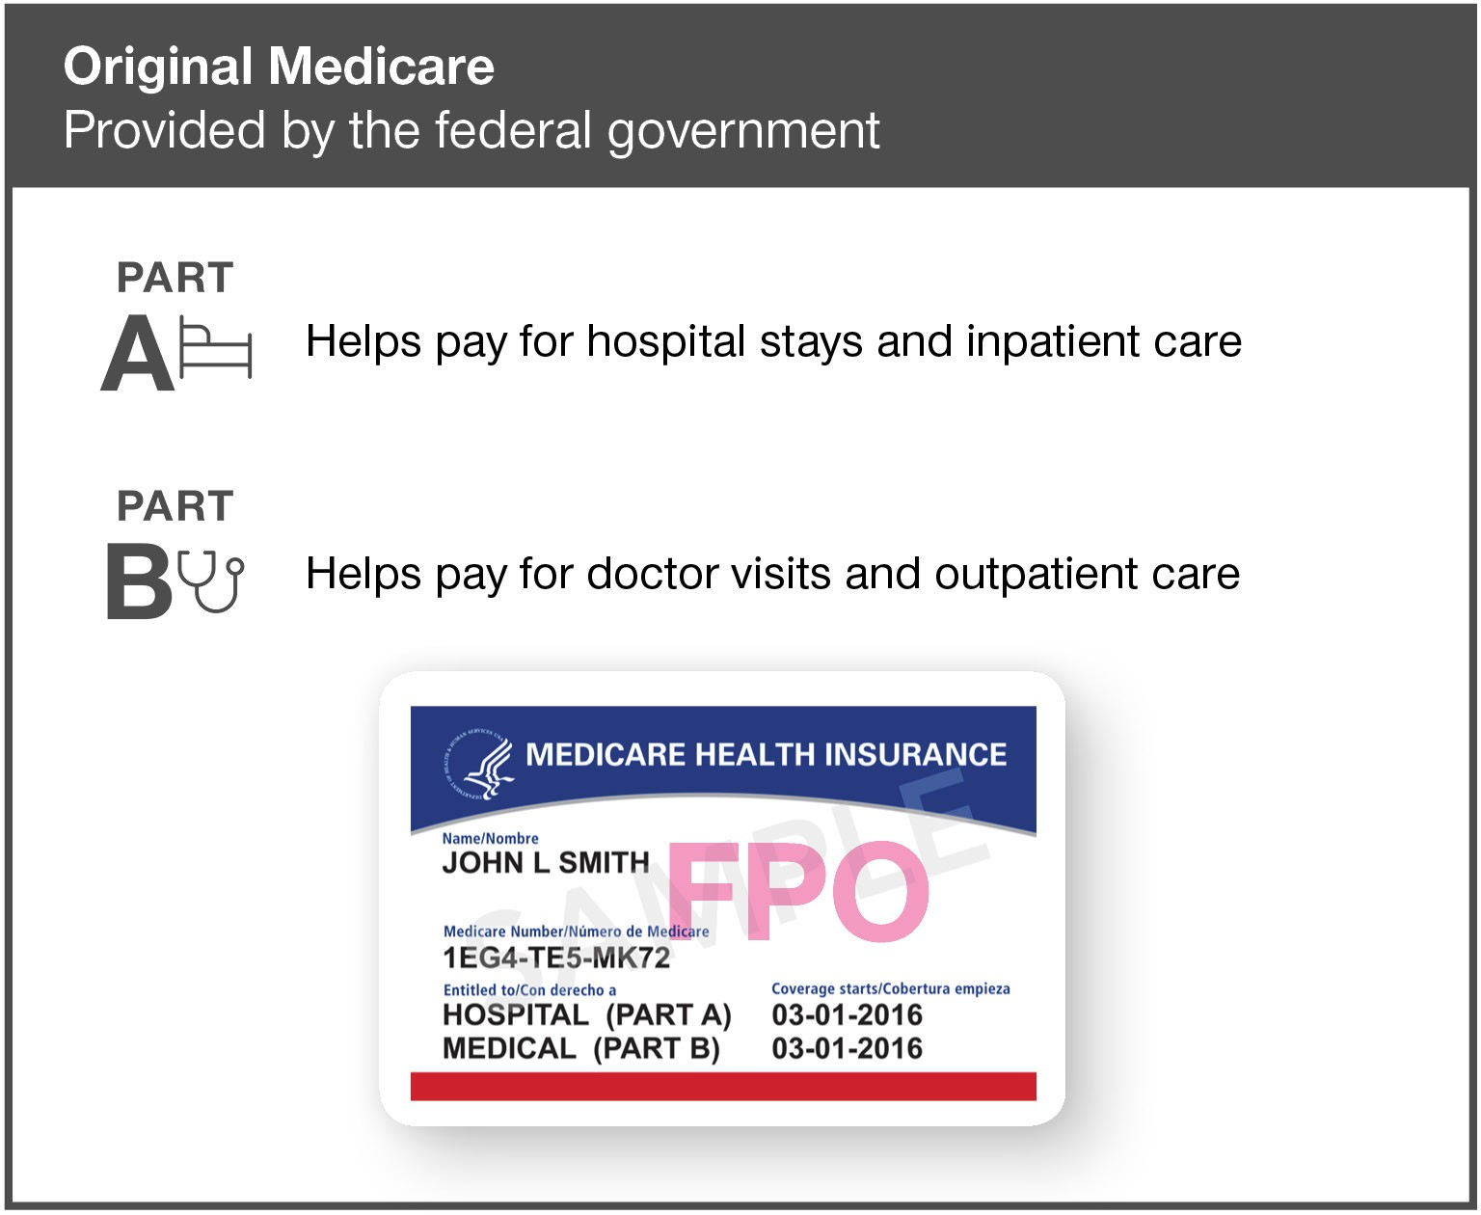
Parts A & B: Original Medicare
Original Medicare has two parts:
  Part A is hospital insurance
  Part B is medical insurance

Slide 5
Medicare A: Hospital Insurance
Quick Overview
  Premium free if you or your spouse worked and paid taxes for 10 years or longer
  Can’t be denied coverage
  Coverage is nationwide, including any qualified hospital in the U.S.
  Coverage and costs are per “benefit period”
  Must be admitted as an inpatient (not on “observation status”)
  Provides additional 60 “lifetime reserve” days

Slide 6
2023 Medicare A (Hospital) Costs
$0 premium for most people
Deductible of $1,600 per benefit period (benefit period is up to 60 days)
Other Costs
  $400 per days 61-90 in one benefit period
  $800 per lifetime reserve day (maximum of 60 days)
  $200.00 Skilled Nursing Facility coinsurance
NO out of pocket limit

Slide 7
Medicare Part B: Medical Insurance
Quick Overview
  Monthly premium, adjusted for income
  Can’t be denied coverage
  Coverage is nationwide, including any provider who accepts Medicare
  Premium penalty for late enrollment

Slide 8
Medicare Part B Premiums
If your adjusted gross income in 2021 (for what you pay in 2023) was |  |  | You pay each month (in 2023)
File individual tax return | File joint tax return | File married & separate tax return
$97,000 or less | $194,000 or less | $97,000 or less | $164.90
above $97,000 up to $123,000 | above $194,000 up to $246,000 | Not applicable | $230.80
above $123,000 up to $153,000 | above $246,000 up to $306,000 | Not applicable | $329.70
above $153,000 up to $183,000 | above $306,000 up to $366,000 | Not applicable | $428.60
above $183,000 and less than $500,000 | above $366,000 and less than $750,000 | above $97,000 and less than $403,000 | $527.50
$500,000 or above | $750,000 and above | $403,000 and above | $560.50

Slide 9
Medicare Part B (Medical) Costs
Most people pay $164.90 per month
Annual Deductible $226 (Can change in the future)
20% of approved amount for most covered services
Excess charges (if any)
NO out of pocket limit

Slide 10
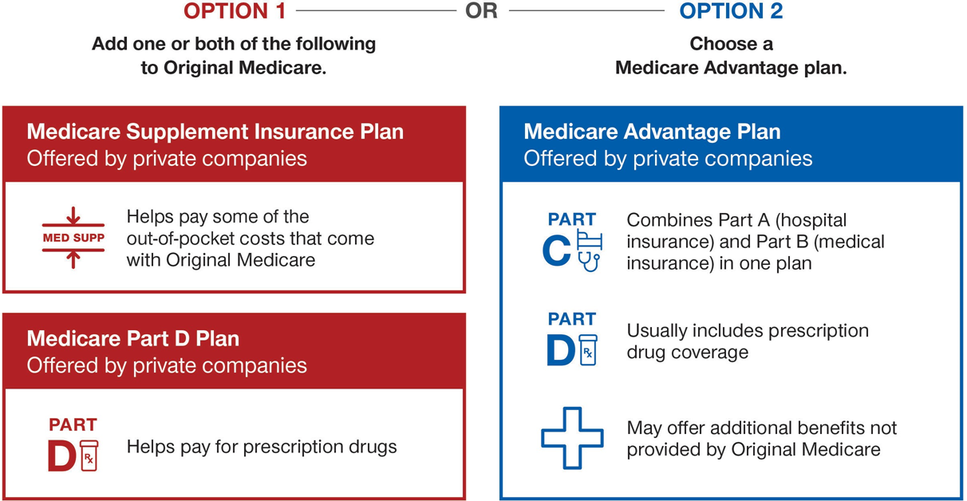
Options For More Coverage

Slide 11
Medicare Advantage
  All Medicare Advantage plans cover:
    All the benefits of Part A (except hospice care, which is still covered by Part A)
    All the benefits of Part B
  Most Medicare Advantage plans cover:
    Prescription drugs
  Medicare Advantage plans may offer additional benefits, such as:
    Dental exams, cleanings and X-rays
    Eye exams, eyeglasses and corrective lenses
    Hearing tests and hearing aids
    Wellness programs and fitness memberships
Medicare Advantage plans have an annual out-of-pocket maximum to help protect against high hospital and medical costs.

Slide 12
Medicare Advantage
Quick Overview
  Must be enrolled in both Medicare Part A and Part B and live in plan service area
  Can’t be denied coverage based on current financial or health status, including pre-existing conditions
  May be required to use provider and pharmacy networks
  Coverage and costs vary by plan and may change each year
  Annual limit on out-of-pocket costs for covered services
  May charge a monthly plan premium
  Must continue to pay Part B premium to Medicare

Slide 13
Medicare Advantage Plan Types
Coordinated care plans
  Health Maintenance Organization plans (HMO)
  Preferred Provider Organization plans (PPO)
  Point of Service plans (POS)
  Special Needs Plans (SNP)
Other plan types
  Private Fee-For-Service plans (PFFS)
  Medical Savings Account plans (MSA) New to Georgia in 2020

Slide 14
Medicare Supplement Insurance: Medigap
Helps pay some costs not paid by Medicare
  Supplements Original Medicare (Part A and Part B)
  Can’t be used with Medicare Advantage
  10 plans with benefits standardized by the federal government
  Plans offered by private insurance companies in your state

Slide 15
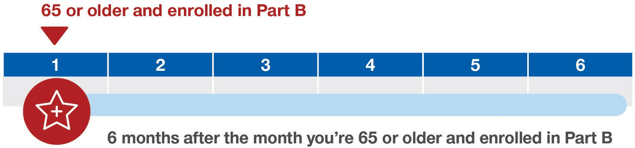
Medicare Supplement Open Enrollment
No medical underwriting if you enroll during this time
May enroll in a plan later but could be denied or charged more based on health history

Slide 16
Medicare Supplement Insurance: Medigap
Plans may help pay:
  Part A and Part B deductibles
  Copays, coinsurance and provider excess charges
  Cost for extra 365 days of hospital care after lifetime reserve days are used
  Cost of blood transfusions, first 3 pints
  Cost of foreign travel emergency, up to plan limit
Plans do not help with:
  Prescription drugs
  Routine dental, vision or hearing care*
  Eyeglasses, contacts or hearing aids
  Extra days in a skilled nursing facility after Part A benefit
  Custodial or Long Term Care (help bathing, eating, dressing)

Slide 17
Standardized Medicare Supplement Plans
Benefits
A
B
C
D
F
*
G
K
L
M
N
Medicare Part A
and hospital
100%
100%
100%
100%
100%
100%
100%
100%
100%
100%
coinsurance
costs (up to an additional
365 days after Medicare
benefits are used)
Medicare Part B
100%
100%
100%
100%
100%
100%
50%
75%
100%
100%
coinsurance or
copayment
**
Blood (first 3 pints)
100%
100%
100%
100%
100%
100%
50%
75%
100%
100%
Part A hospice care
100%
100%
100%
100%
100%
100%
50%
75%
100%
100%
coinsurance or copayment
Skilled nursing facility care
100%
100%
100%
100%
50%
75%
100%
100%
coinsurance
Part A
deductible
100%
100%
100%
100%
100%
50%
75%
50%
100%
Part B deductible
100%
100%
Part B excess charges
100%
100%
Foreign travel emergency
80%
80%
80%
80%
80%
80%
(up to plan limits)
Out
-
of
-
pocket limit
In 2023
$6,620
$3,310

Slide 18
Medicare Prescription Drug Coverage
Helps with the cost of prescription drugs
  Two ways to get coverage:
    Add a standalone Part D plan to Original Medicare
    Choose a Medicare Advantage plan that includes prescription drug coverage
Plans offered by private insurance companies

Slide 19
Medicare Prescription Drug Coverage
Medicare Part D plans cover:
  Types of drugs most commonly prescribed for Medicare beneficiaries as determined by federal standards.
  Specific brand name drugs and generic drugs included in the plan’s formulary, or list of drugs
  Commercially available vaccines not covered by Part B
Tiered Formularies
  Drugs are grouped into tiers based on cost
  In general, the lower the tier, the lower the cost
  Deductibles may be charged by tier

Slide 20
Prescription Drug Plan Costs
Annual Deductible | Initial Coverage | Coverage Gap (Donut Hole) | Catastrophic Coverage
For 2023 a plan can have a deductible of $505 | Up to $4,660 total drug costs. | Up to $7,400 out of pocket costs | To the end of the calendar year.
Amount paid for prescriptions depends on
stage.
Dollar limits can change each year
Not all plans have a deductible.
Many people never reach the coverage gap.
25% of the cost of Brand Names in the coverage gap
25% of the cost of Generic Drugs in the coverage gap
Cycle starts over January 1 each year.

Slide 21
Prescription Drug Plan Costs
Annual Deductible | Initial Coverage | Coverage Gap (Donut Hole) | Catastrophic Coverage is gone
For 2024 a plan can have a deductible up to $545 | Up to $5,030 Total drug costs. | Up to $8,000 out of pocket costs | 100% coverage after reaching the total out of pocket costs.
Amount paid for prescriptions depends on stage.
Dollar limits can change each year
Not all plans have a deductible.
Many people never reach the coverage gap.
25% of the cost of Brand Names in the coverage gap
25% of the cost of Generic Drugs in the coverage gap
Cycle starts over January 1 each year.
Robert Fitzgerald Insurance Agency, Inc. (678)402-1515 www.georgiamedicareplan.com

Slide 22
Medicare Part D Premiums
If your filing status and yearly income in 2021 was
File individual tax return | File joint tax return | File married & separate tax return | You pay each month (in 2023)
$97,000 or less | $194,000 or less | $97,000 or less | your plan premium
above $97,000 up to $123,000 | above $194,000 up to $246,000 | not applicable | $12.20 + your plan premium
above $123,000 up to $153,000 | above $246,000 up to $306,000 | not applicable | $31.50 + your plan premium
above $153,000 up to $183,000 | above $306,000 up to $366,000 | not applicable | $50.70 + your plan premium
above $183,000 and less than $500,000 | above $366,000 and less than $750,000 | above $97,000 and less than $403,000 | $70.00 + your plan premium
$500,000 or above | $750,000 and above | $403,000 and above | $76.40 + your plan premium

Slide 23
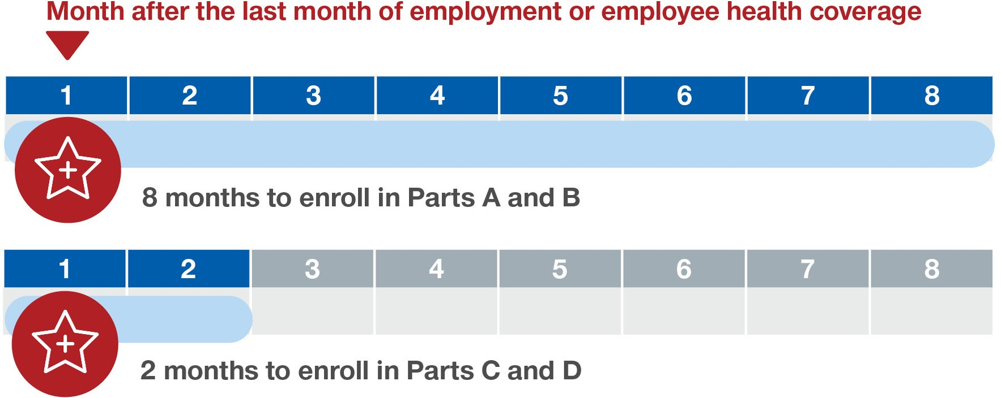
Special Enrollment Period: Working Past 65
For those who delayed enrollment
May enroll in Part A, Part B or both
May choose to enroll in a Part C or
Part D plan
Part B enrollment triggers Medicare Supplement Open Enrollment

Slide 24
Late Enrollment Penalties
Medicare A
  None if qualified for premium free
  Otherwise 10%
Medicare Part B
  None if qualified for SEP
  Otherwise 10% for each 12-month period
Medicare Part D
  None if less than 63 days without credible coverage
  Otherwise 1% of current average premium for each month.

Slide 25
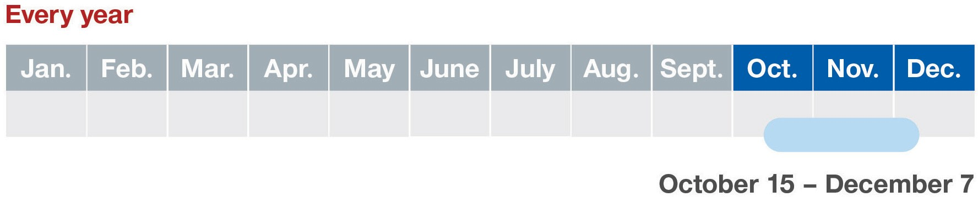
Medicare Annual Enrollment Period AEP
Switch from Original Medicare (Parts A & B) to a Medicare Advantage plan (Part C), or vice versa.
Switch from one Medicare Advantage Plan to another.
Join, switch or drop a Medicare Prescription Drug Plan

Slide 26
Medicare Open Enrollment Period OEP
January 1st – March 31st
Switch from one Medicare Advantage Plan to another.
Drop your Medicare Advantage Plan and return to Original Medicare, Part A and Part B
Sign up for a stand-alone Medicare Part D Prescription Drug Plan. Usually a Medicare Advantage Plan includes drug coverage. Once you sign up with a Part D Prescription Plan it will drop you from your Medicare Advantage Plan and return you to Medicare Part A and Part B. You can enroll in a Medigap (Medicare Supplement Plan) once you are no longer on a Medicare Advantage Plan, if you can medically qualify.

Slide 27
Special Enrollment Period: Qualifying Events
Move out
Move out of plan service area
Move
Move within plan service area and have new plan options
Leave or Lose
Leave or lose retiree or union coverage
Lose
Lose credible drug coverage
Move
Move into or out of an institution, such as a nursing home
Get or Lose
Get or lose financial help with Medicare

Slide 28
Common Misunderstandings
HSA & High Deductible Plans
Group size matters
COBRA
How and when to enroll

Slide 29
Are Medicare calls out of hand?
Is your phone ringing off the hook?
Are you receiving calls prior to 8 am or after 9 pm?
On the DNC list but still getting calls?

Slide 30
Are Medicare calls out of hand?
These calls violate FCC guidelines.
YOU CAN STOP THEM!
What can you do?
List your phone number with the National Do Not Call (DNC) registry: www.DoNotCall.gov
To verify your registration, you must open the confirmation email.
Call 1-888-382-1222 from the phone you wish to register.

Slide 31
Are Medicare call out of hand?
File a complaint with the FCC at:
www.consumercomplaints.fcc.gov

Slide 32
Are Medicare calls out of hand?
What is allowed?
Some calls you receive may be legitimate and permitted by regulations.
Examples include:
Calls from an online Medicare inquiry.
Calls from a ‘consent to contact’ form that you completed for information.
Calls from your current Medicare plan provider to discuss your plan benefits and/or other information.

Slide 33
Are Medicare calls out of hand?
WHAT IS NOT ALLOWED?
Calls made prior to 8 am or after 9 pm.
Calls made if you are listed on the DNC (do not call registry).
People calling from fake or randomized numbers.

Slide 34
Are Medicare calls out of hand?
Ask for the caller’s National Producer Number (NPN)
Ask the caller for his name
Ask where they are calling from
Make a note of the phone number
Note the time of the call

Slide 35
Questions

